Slide 1



Bookmarks
By: Dhir Patel

Slide 2


Overview
SDLC
01
Design
02
Jira
03
Demo
04

Slide 3
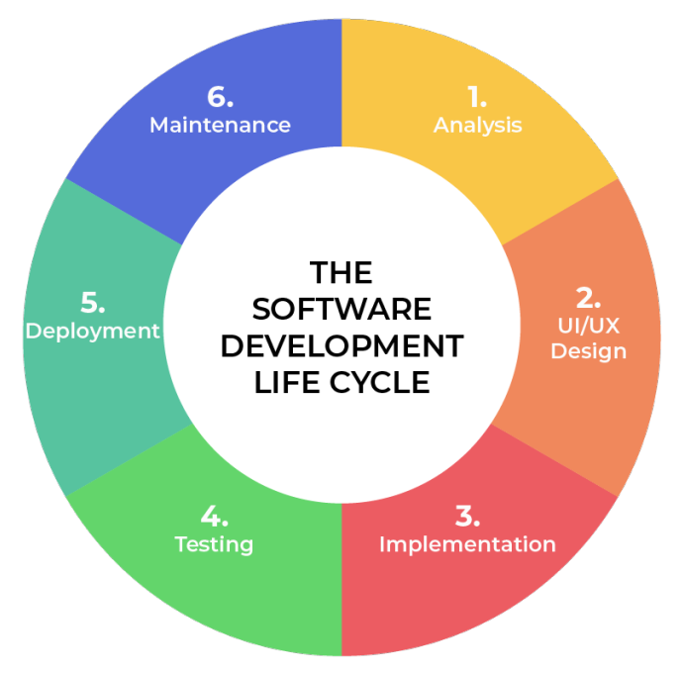
Software Devlopment
Life Cycle
Planning
Designing
Coding
Testing
Deploying
Maintaining

Slide 4
Home Page

Slide 5

Login Page

Slide 6
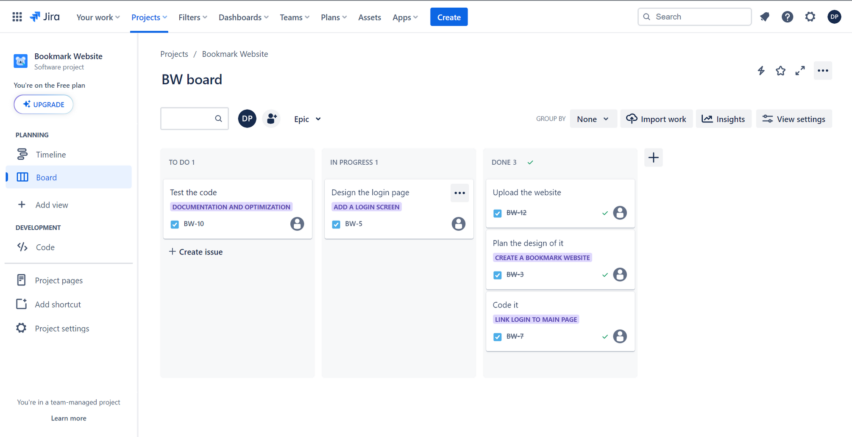
Jira

Slide 7






THANK YOU!
🤨
Dhir Patel
CEO & Founder
+123-456-7890
BookMark.com
85th Board Street, New York

